Slide 1
REST & Ajax
Frictionless Flow of Information
Notes:
For PostMan installation, see p205 – 1st edition p235 – 2nd edition

Slide 2
REST Web Services
REST = REpresentational State Transfer
REST is an architectural style consisting of a coordinated set of architectural constraints
First described in 2000 by Roy Fielding in his doctoral dissertation at UC Irvine
RESTful is typically used to refer to web services implementing a REST architecture
Alternative to other distributed-computing specifications such as SOAP
Simple HTTP client/server mechanism to exchange data
Everything – the UNIVERSE is available through a URI
Utilizes HTTP: GET/POST/PUT/DELETE operations

Slide 3
Architectural Constraints
Uniform interface
  Individual resources are identified in requests, i.e.,using URIs in web-based REST systems.
Client-server
  Separation of concerns. A uniform interface separates clients from servers.
Stateless
  The client-server communication is further constrained by no client context being stored on the server between requests.
Cacheable
  Basic WWW principle: clients can cache responses.
Layered system
  A client cannot necessarily tell whether it is connected directly to the end server, or to an intermediary along the way.
Code on demand (optional)
  REST allows client functionality to be extended by downloading and executing code in the form of applets or scripts. This simplifies clients by reducing the number of features required to be pre-implemented.
Notes:
https://restfulapi.net/rest-architectural-constraints/
Uniform Interface: As the constraint name itself applies, you MUST decide APIs interface for resources inside system which are exposed to API consumers and follow religiously. A resource in system should have only one logical URI, and then should provide way to fetch related or additional data.
Client–server
This essentially means that client application and server application MUST be able to evolve separately without any dependency
on each other. Client should know only resource URIs and that’s all. Today, this is normal practice in web development so nothing fancy is required from your side. Keep it simple.
Stateless
Roy fielding got inspiration from HTTP, so it reflects in this constraint. Make all client-server interaction stateless. Server will not store anything about latest HTTP request client made. It will treat each and every request as new. No session, no history.
Cacheable
In today’s world, caching of data and responses is of utmost important wherever they are applicable/possible. The webpage you are reading here is also a cached version of HTML page. Caching brings performance improvement for client side, and better scope for scalability for server because load has reduced.
In REST, caching shall be applied on resources when applicable and then these resources MUST declare themselves cacheable. Caching can be implemented on server or client side.
Layered system
REST allow you to use a layered system architecture where you deploy the APIs on server A, and store data on server B and authenticate requests in Server C, for example. A client cannot ordinarily tell whether it is connected directly to the end server, or to an intermediary along the way

Slide 4
RESTful compared to SOAP Services
RESTFUL
SOAP
No significant tools required to interact with the Web service
Smaller learning curve
Efficient (SOAP uses XML for all messages, REST can use smaller message formats)
Fast (no extensive processing required)
Closer to other Web technologies in design philosophy
RPC style – short burst messages
Explosive growth in commercial end user applications
Language, platform, and transport independent (REST requires use of HTTP)
Works well in distributed enterprise
environments (REST assumes direct point-to-point comm.)
Standardized
Built-in error handling
Provided document style to better represent domain model
Strong enterprise adoption – B2B
Unlike SOAP-based web services, there is no "official" standard for RESTful web APIs

Slide 5
RESTful API HTTP methods
Resource | GET | PUT | POST | DELETE
Collection URI, such as http://example.com/resources | List the URIs and perhaps other details of the collection's members. | Replace the entire collection with another collection. | Create a new entry in the collection. The new entry's URI is assigned automatically and is usually returned by the operation. | Delete the entire collection.
Element URI, such as http://examples.com /resources/item17 | Retrieve a representation of the addressed member of the collection, expressed in an appropriate Internet media type. | Replace the addressed member of the collection, or if it doesn't exist, create it. | Not generally used. Treat the addressed member as a collection in its own right and create a new entry in it. | Delete the addressed member of the collection
A resource can be a singleton or a collection. For example, “customers” is a collection resource and “customer” is a singleton. We can identify “customers” collection resource using the URN “/customers”. We can identify a single “customer” resource using the URN “/customers/{customerId}”.
POST means "create new" as in "Here is the input for creating a user".
PUT means "insert, replace if already exists" as in "Here is the data for user 5".
PUT is Idempotent
Idempotent means that multiple calls with the same operation doesn’t change the representation
Notes:
https://restfulapi.net/http-methods/#summary
It is still possible, that safe methods do change things on a server or resource, but this should not reflect in a different representation.
PUT being Idempotent does NOT mean SAFE as the first call can change the representation…as well as subsequent can change timestamp etc..
http://searchmicroservices.techtarget.com/definition/URN-Uniform-Resource-Name
http://www.kennethlange.com/posts/The-Ultimate-Checklist-for-REST-APIs.html
GET
The purpose of the GET method is to retrieve resources.
POST
The purpose of the POST method is to add a new element to a collection resource.
Use PUT to UPDATE data ………….idenmpotent
- Use POST to ADD data
- Use DELETE to REMOVE data
Use GET to RETREIVE data
https://en.wikipedia.org/wiki/Representational_state_transfer
https://knpuniversity.com/screencast/rest/put-versus-post
http://zacharyvoase.com/2009/07/03/http-post-put-diff/
https://stormpath.com/blog/put-or-post
POST means "create new" as in "Here is the input for creating a customer, create it for me".
PUT means "insert, replace if already exists" as in "Here is the data for user 5".
You POST to example.com/users since you don't know the URL of the user yet, you want the server to create it.
You PUT to example.com/users/id since you want to replace/create a specific user.

Slide 6
Spring MVC REST-style Controller
Essentially means receive & send the content directly as the message body instead of structuring HTML pages.
We are NOT using HTML
We are using well-formed XML OR JSON
Spring support is based on the
  @RequestBody & @ResponseBody annotations
  @ResponseStatus(value = HttpStatus.NO_CONTENT)
    For deletes, creates, updates…
  @RestController = @Controller + @ResponseBody

Slide 7
RequestBody & ResponseBody
@ResponseBody
  Spring framework uses the "Accept" header of the request to decide the media type to send to the client.
@RequestBody
  Spring framework will use the " Content-Type" header to determine the media type of the Request body received.
To get XML, MIME media type = "application/xml"
To get JSON, MIME media type = "application/json"
Notes:
https://dzone.com/articles/spring-framework-restcontroller-vs-controller

Slide 8
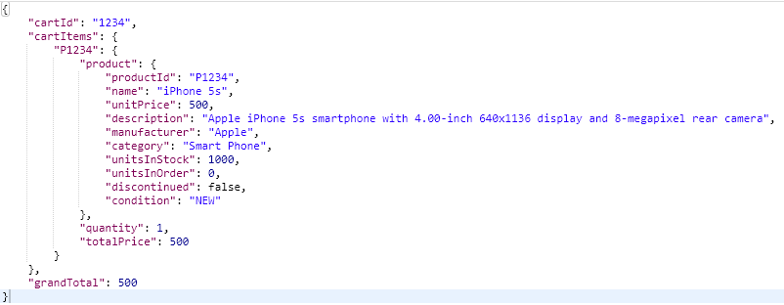
JSON (JavaScript Object Notation)

Slide 9
RESTful Web Service CartRestController
@Controller
public class CartRestController {
  @Autowired
  private CartService cartService;
  @RequestMapping(method = RequestMethod.POST)
  public @ResponseBody Cart create(@RequestBody Cart cart) {
  return cartService.create(cart);
  }
  @RequestMapping(value = "/{cartId}", method = RequestMethod.GET)
  public @ResponseBody Cart read(@PathVariable(value = "cartId") String cartId) {
  return cartService.read(cartId);
  }
  @RequestMapping(value = "/add/{productId}", method = RequestMethod.PUT)
  @ResponseStatus(value = HttpStatus.NO_CONTENT)
  public void addItem(@PathVariable String productId, HttpServletRequest request) {
  //Code omitted
  }
} See demo: webstore_rest
Notes:
Removed @RequestMapping(value = "rest/cart") on Class level

Slide 10
HATEOAS
HATEOAS (Hypermedia as the Engine of Application State) is a constraint of the REST application architecture that keeps the RESTful style architecture unique from most other network application architectures.
“hypermedia”: refers to any content that contains links to other forms of media such as images, movies, and text.
lets you use hypermedia links in the response contents so that the client can dynamically navigate to the appropriate resource by traversing the hypermedia links.
{
"id": 1,
"name": "Computing",
"description": null,
"_links": {
"all-categories": {
"href": "http://localhost:9999/categories"
},
"all-categories2": {
"href": "http://localhost:9999/categories"
}
}
}
Notes:
This is conceptually the same as a web user navigating through web pages by clicking the appropriate hyperlinks in order to achieve a final goal.
rel means relationship. In this case, it's a self-referencing hyperlink. More complex systems might include other relationships. For example, an order might have a "rel":"customer" relationship, linking the order to its customer.
href is a complete URL that uniquely defines the resource.

Slide 11
Versioning
Media type versioning (a.k.a “content negotiation” or “accept header”
  Github
(Custom) header versioning
  Microsoft
URI versioning
  Twitter
Request Parameter versioning
  Amazon
Factors
  URI Pollution
  Misuse of HTTP Headers
  Caching
  Execute the request on the browser
  API Documentation
Notes:
There are so many choices and different people opt for different choices.
I don't think there's one good way to do that.
There are tradeoffs.
Irrespective of the way you're doing versioning.
that you’d need to consider when you talk about URI versioning
are basically, think about the URI pollution.
If you look at the URI versioning and the request paramter versioning, we are actually polluting the URI space.
(Media Type Versioning, Header Versioning) what is called misuse of HTTP headers. HTTP header were never intended for versioning.
Caching: And the other important factor is cashing. Because these two approaches (Media Type Versioning, Header Versioning) use headers to differentiate
between the requests, the caching can never come into picture because I cannot cache requests because
they have the same URI. I would also need to look at the headers and do complicated things like that.
So caching becomes very difficult here. But in these two options URI versioning and request paramter
versioning
I can still cache them because the version is part of the URI.
(Media Type Versioning, Header Versioning) : need extra knowledge – cannot execute in browser

Slide 12
Documentation
REST API Elements
  Resource descriptions
  Endpoints and methods
  Parameters
  Request example
  Response example
Swagger
  An open spec for describing REST APIs [ github ]
  Tools for auto-generating
    Documentation
    Code for your API
  Donated to the OpenAPI initiative and renamed OpenAPI in 2015
Mashery
  An open source project [ github ]
  Tools for generating
    Documentation
    An exploration interface for your API
Apiary and API Blueprint
  Write the API description in a DSL within markdown
  Tools for auto-generating
    Documentation
    Mock server
  Seems to be focused on ruby+mac devs
RAML
  A spec for describing REST APIs [ github ]
WADL
  A spec for writing discoverable API docs with XML
  Some discussion comparing WSDL and WADL
  Java specific
Notes:
That's the version of the specification we're using. The info tag contains the high level information
about our API.
What kind of API are we offering and that kind of stuff. And the host is where we are hosting the service
or where we're hosting the API.
The base path is the base path, so the base path is slash API. Then to call the services you'd need to use
localhost 8080 slash API. And tags or something which you can use to group your resources. So for each of your
resources and resource methods, you can assign tags and tags can be used to group your resources into
multiple categories or things like that. Paths include the details of all the resources that we are exposing
and the different operations that can be performed on each of these resources.
The definitions include the different elements that are used in our APIs. For example, what does the
user contain?
What are the different elements inside the user?
What are the different elements inside the hello world bean.
That's what is provided by the definitions. There are three important parts we would need to dig into details.
Info, path and definitions.

Slide 13
Richardson Maturity Model
Level 0
  Expose SOAP Web Services in REST Style
    http://server/getPosts
    http://server/deletePosts
    http://server/doThis
Level 1
Expose Resources with Proper URI
  Note: Improper use of HTTP Methods
    http://server/accounts
    http://server/accounts/10
Level 2
  Level 1 + HTTP Methods
Level 3
  Level 2 + HATEOAS
  Data + Next Possible Actions
Notes:
You're doing REST, you're calling your services RESTful but how RESTful are you?
Richardson Maturity Model helps you evaluate this.
It defines three different levels of RESTful services.

Slide 14
Main Point
REST is defined by architectural constraints. It is able to access information through the ubiquitous URI. Everything on the web is available through a URI.
Everything in creation is known through understanding and experience of the Unified Field of Consciousness

Slide 15
Web 2.0
WWW sites that emphasize user-generated content, usability, and interoperability.
Update selected regions of the page area without undergoing a full page reload.
Ajax and JavaScript frameworks:
  YUI Library - Dojo Toolkit - Moo Tools - jQuery
  Ext JS - Prototype JavaScript Framework
  Ember.js, React.js, AngularJS,Backbone.js
Payload - typically formatted in XML or JSON
NOTE: we will use Spring MVC REST technology to create the Web 2.0 payload

Slide 16
AJAX
Asynchronous Javascript And XML
Web applications are able to make quick, incremental updates to the client without reloading the entire browser page
The use of XML is not required; JSON is often used instead ( AJAJ)
Examples :
  Validate values of form fields before saving
  Dynamically load dropdown values from database
  Load table data and paginations
  Live Search
Ajax - a broad group of Web technologies that communicates with a server in the background, without interfering with the current state of the page.

Slide 17
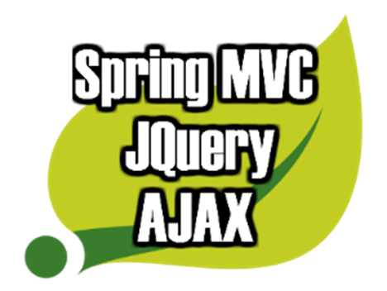
JQuery
SLOGAN: The Write Less, Do More, JavaScript Library.
Fast, small, and feature-rich JavaScript library.
HTML document traversal and manipulation, event handling, animation, and Ajax.

Slide 18
cart.js
RESTful services:
addToCart - Add Item
removeFromCart - Remove Item

Slide 19
cart.html consumes cart.js example
Include js files
  <script type="text/javascript“ src="http://code.jquery.com/jquery-1.10.1.min.js"></script>
  <script type="text/javascript" th:src="@{/js/cart.js}"></script>
  Bind data for adding item function
  <a href="#" class="btn btn-warning btn-large order-btn" th:data="${product.productId}">
  <span class="glyphicon-shopping-cart glyphicon"></span> Order Now </a>
  Bind data for removing item function
<a href="#" class="label label-danger product-remove-btn" th:data="${item.value.product.productId}">
<span class="glyphicon glyphicon-remove" /></span> Remove</a>
See demo: webstore_rest

Slide 20
cart.js – register adding item function
$('.order-btn').click(function(event){
  event.preventDefault();
  var productId = $(this).attr("data");
  $.ajax({
    url: '/rest/cart/add/' + productId,
    type: 'PUT',
    dataType: "json",
    success: function(response){
    alert("Product Successfully added to the Cart!");
    },
    error: function(){
    alert('Error while request..');
    }
  });
});
Replace
var contextRoot = "/" + window.location.pathname.split('/')[1];
url: contextRoot + '/rest/cart/add/' + productId,

Slide 21
cart.js – register removing from cart
$('.product-remove-btn').click(function(event){
  event.preventDefault();
  var productId = $(this).attr("data");
  $.ajax({
    url: '/rest/cart/remove/'+ productId,
    type: 'PUT',
    dataType: "json",
    success: function (response) {
    location.reload(true);
    },
    error: function(){
    alert('Error while request..');
    }
  });
});

Slide 22
RESTful input Validation
How does THAT work?
XML - Schema validation is generally not a good idea in a REST service.
A major goal of REST is to decouple client and server so that they can evolve separately.
What about JSON validation/consistency?
API producers have frequently developed their own JSON response formats in the absence of well-defined standards.
ALTERNATIVE OPTION: JSR-303 Bean Validation
Notes:
https://www.javacodegeeks.com/2013/08/how-to-implement-input-validation-for-rest-resources.html
More importantly, schema validation is generally not a good idea in a REST service.
A major goal of REST is to decouple client and server so that they can evolve separately.
If we validate against a schema, then a new client that sends a new property would break against an old server that doesn’t understand the new property. It’s usually better to silently ignore properties you don’t understand.
JAX-B does this right, and also the other way around: properties that are not sent by an old client end up as null. Consequently, the new server must be careful to handle null values properly.

Slide 23
category.html
<form id="categoryForm" method="post">
  <p>
    <label for="name"> Name : </label>
    <input type="text" name="name" id="name" value="" />
  </p>
  <p>
    <label for="description"> Description: </label>
    <input id="description" name="description" type="text" />
  </p>
  <input type="button" id="categorySubmitBtn" value="Add Category"/>
</form>

Slide 24
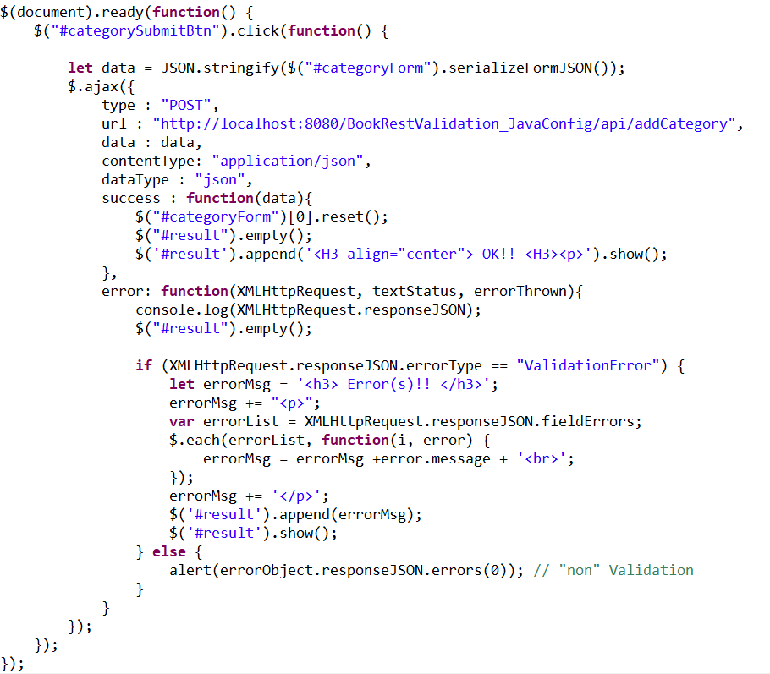
AJAJ Call
The JSON.stringify() method converts a JavaScript value/object to a JSON string EXAMPLE:
JSON.stringify({ x: 5, y: 6 }); yields '{"x":5,"y":6}'
serializeFromJSON – custom function to take form data and structure it as a JSON object
e.g. [{ x: 5, y: 6 }]

Slide 25
RequestBody & ResponseBody
@RestController
public class CategoryRestController {
  @Autowired
  private CategoryService categoryService;
  // @Valid - but NO BindResult! an exception will be thrown...
  @CrossOrigin(origins = { "http://localhost:9080", "http://localhost:9000" }, maxAge = 6000)
  @PostMapping(value="/api/addCategory", produces = "application/json")
  public Category saveCategory(@Valid @RequestBody Category category) {
    categoryService.save(category);
    return category;
  }
}
if NO BindingResult bindingResult in Signature,
MethodArgumentNotValidException will be thrown if Category fails validation...

Slide 26
Form Validation Exception Handling
@ControllerAdvice
public class RestErrorHandler {
  @Autowired
  private MessageSourceAccessor messageSourceAccessor;
  @ExceptionHandler(MethodArgumentNotValidException.class)
  @ResponseStatus(HttpStatus.BAD_REQUEST)
  @ResponseBody
  public ValidationErrorDTO processValidationError(MethodArgumentNotValidException ex) {
    BindingResult result = ex.getBindingResult();
    List<FieldError> fieldErrors = result.getFieldErrors();
    return processFieldErrors(fieldErrors);
  }
  private ValidationErrorDTO processFieldErrors(List<FieldError> fieldErrors) {
    ValidationErrorDTO dto = new ValidationErrorDTO("ValidationError");
    for (FieldError fieldError : fieldErrors) {
    dto.addFieldError(fieldError.getField(), messageSourceAccessor.getMessage(fieldError));
    }
  return dto;
}
See demo:
BookRestValidation_JavaConfig
BookRestValicationWeb_JavaConfig
BookRestValidation
Book5Rest
<bean id="messageSourceAccessor" class="org.springframework.context.support.MessageSourceAccessor">
<constructor-arg ref="messageSource"/>
</bean>

Slide 27
Validator Error DTOs
/**
* This DTO contains the information of a single validation error.
*/
public class FieldErrorDTO {
  private String field;
  private String message;
}
/**
* This DTO wraps those validation errors together
*/
public class ValidationErrorDTO {
  private String errorType;
  private List<FieldErrorDTO> fieldErrors = new ArrayList<>();
  public void addFieldError(String path, String message) {
  FieldErrorDTO error = new FieldErrorDTO(path, message);
  fieldErrors.add(error);
  }
}

Slide 28
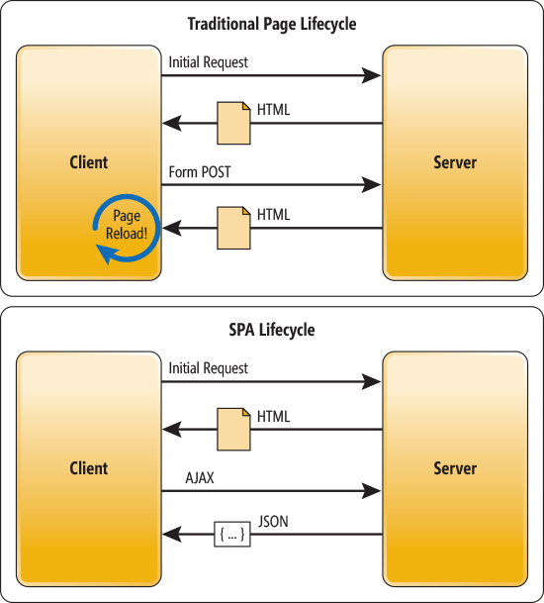
Spring MVC Rest Controller & SPA
Web application that fits on a single to provide a more fluid user experience.
All the “heavy lifting” presentation-wise is done on the client side, in JavaScript.
Server interaction with a SPA involves dynamic communication with the web server behind the scenes [RE: Ajax].
Spring RESTful Controller is a perfect fit for Server side support of SPA.
SPA
Spring MVC

Slide 29
Main Point
Ajax uses Javascript in a browser to access data or functionality residing on a server and then quickly and efficiently selectively update the browser.
Nature is maximally efficient.

